Slide 1
Explainable Machine Learning for Day-Ahead Gas Prices: A Model Comparison Using Fundamental Data
Colloquium
Lotta Plenge
23.07.2025

Slide 2
Practical Gap in the Company
Motivation
Theoretical Gap in Research
Little experience with ML
Price forecasts bought externally
Multivariate analysis rarely conducted
No centralized gas market database available
Many univariate gas price forecasts
Some multivariate forecasts
Focus either on performance or interpretability
Variable interactions and model-specific handling remain unexplored
Research gap: Trade-off between performance and interpretability for decision-making in the energy sector
2

Slide 3
Theoretical foundations – 4 Chapters
Overview of the German gas market
Fundamental analysis in gas price forecasting
Machine learning and interpretability in gas price forecasting
Interpretability and explainable AI

Slide 4
Data preprocessing
Integration
Stationarity
Not enforced, unified dataset for all models
Scaling
Only for specific models (e.g. MLP)
Min-Max normalization on training set, test set scaled accordingly, rescaling after prediction
Missing values: dropped, interpolated or filled (bfill/ffill)
Anomaly
Train/test split: 65% / 35%
Filter-based feature selection (correlation), refined by domain knowledge
Resampling for consistent frequency
Peak correction: backward imputation (1 year), original value weighted at 40%
Outliers: Hampel filter (local median + std deviation)

Slide 5
Feature Extraction
Feature engineering
Feature selection: Second part of hybrid feature selection
Lag Features: Capture time dependencies via tabular modeling, lag creation followed data-type-specific logic
Cyclic Features: Encoded seasonal and annual cycles using one-hot encoding
Transformation Features: Rolling stats (means, std, extremes), short windows for volatile series (e.g., prices), longer for stable variables
Initial feature space: 92 (from 17 raw features)
Method: Recursive feature elimination with cross validation as a wrapper method with a DT (RFECV)
Objective: minimize NMAE
Final selection: 12 features
5

Slide 6
Selected features
Variable Name | Description
S-Gas DA D | Day-ahead gas price in Germany
N-Demand LDZ_rollmean_30 | 30-day rolling average of private gas demand
K-Wind speed_rollmean_7 | 7-day rolling average of wind speed
P-European_News_Index_rollmean_30 | 30-day rolling average of European economic news sentiment index
S-Coal Price (close)_lag1 | Coal price (closing value), lagged by 1 day
Season_Winter | Binary indicator for winter season
P-GPR_rollmean_30 | 30-day rolling average of Geopolitical Risk Index
N-Demand LDZ_rollstd_30 | 30-day rolling standard deviation of private gas demand
P-European_News_Index_lag1 | European economic news index, lagged by 1 day
P-GPR_lag1 | Geopolitical Risk Index, lagged by 1 day
S-Coal Price (close)_rollmean_7 | 7-day rolling average of coal price
S-Coal Price (close)_rollstd_3 | 3-day rolling standard deviation of coal price

Slide 7
exPerimental setup
model selection : benchmark (random walk, lasso, prophet), MLP, xgboost, EBM
Metrics: MAE (main focus) and R², MAE preferred for interpretability (same unit)
Experimental Tests: 144 model variants tested (different preprocessing), best without peak correction or month feature
Validation Strategy: TimeSeriesSplit used for validation and tuning to prevent data leakage
TimeSeriesSplit (n_split = 4)
Split 1
Split 2
Split 3
Split 4
01.11.2021
23.03.2022
09.08.2022
26.12.2022
14.05.2023
30.09.2023

Slide 8
Results – performance
Possible Explanations
Data Structure: Many variables follow linear patterns
Model Bias: EBM overweights peaks seen in training, unlike other models that generalize better
Interaction Handling: Advanced models capture complex feature interactions; EBM limited to 2D
Model Fit: Performance depends on structural capacity to model underlying dependencies
Notes:
comparison for three configurations tuned untuned and without gas price)
EBM underperformed, MLP was the best advanced model
the random walk is univariate model had the best results, all baseline models were almost as good as the advanced models
Differences:
In untuned two out of the four baselines outperform the MLP
additional GAM word tested but still lagged behind the others
influence of the gas price it's striking: all models have a massive performance drop but not the prophet
Explanations:
Underlying patterns in the data
a lot of variables show linear relationship
EBM gives weight to the peak and the training set, explaining the poor performance (other models followed without the gas price)
structural capabilities of models to deal with these relationships
analysis showed that many variables interact with each other -> ability of the models to represent the interactions
EBM Is restricted to 2D interactions whereas the other advanced models can capture dimensional interactions

Slide 9
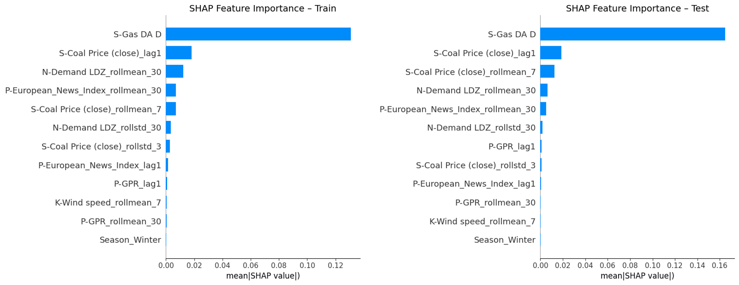
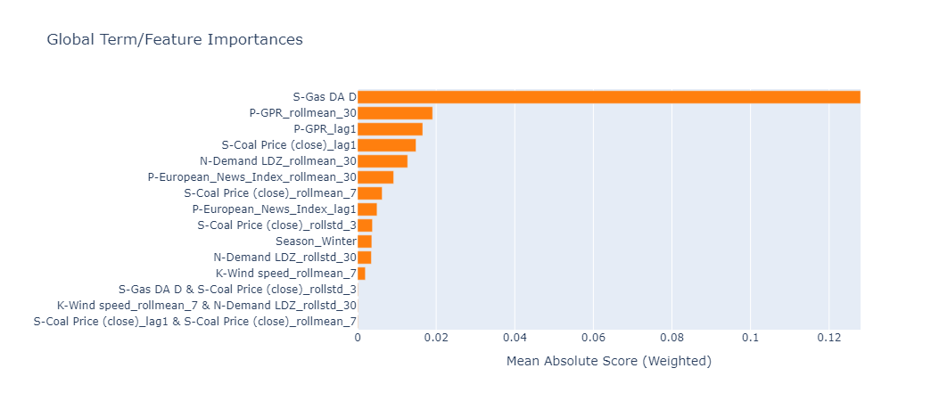
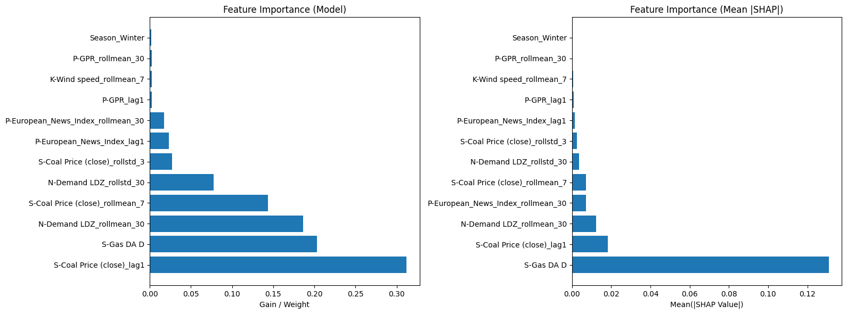
results – interpretability
Interpretability Types: Compared intrinsic (EBM) vs. post-hoc (SHAP) explanations
Feature Rankings: Gas price ranked #1 across all models, other features varied in relevance
EBM Insights: Shape plots for EBM showed no meaningful relationships beyond gas price, detected interactions had no predictive impact

Slide 10
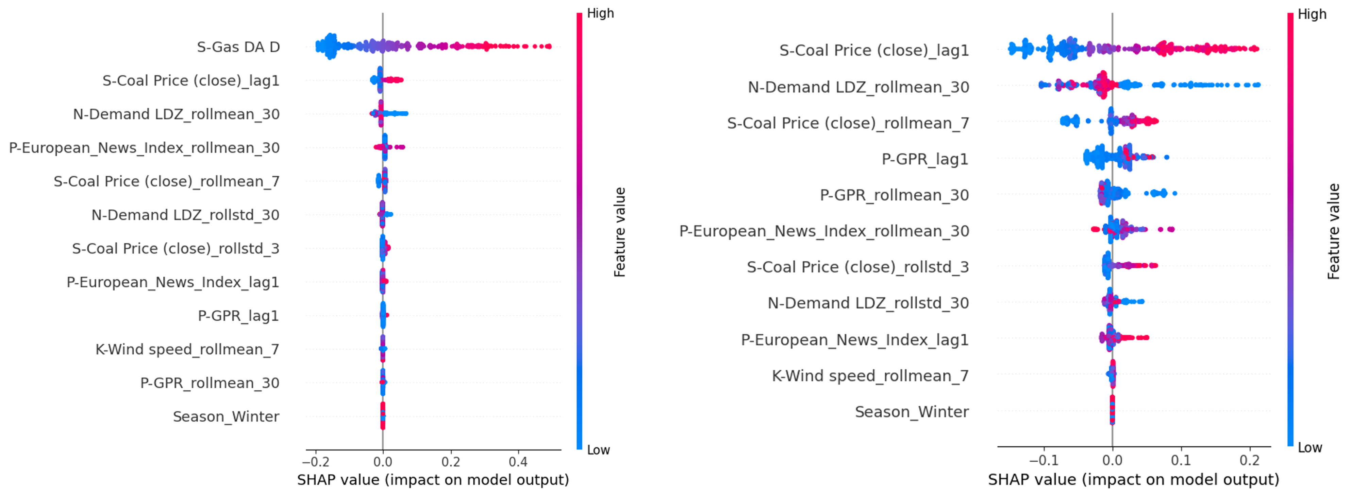
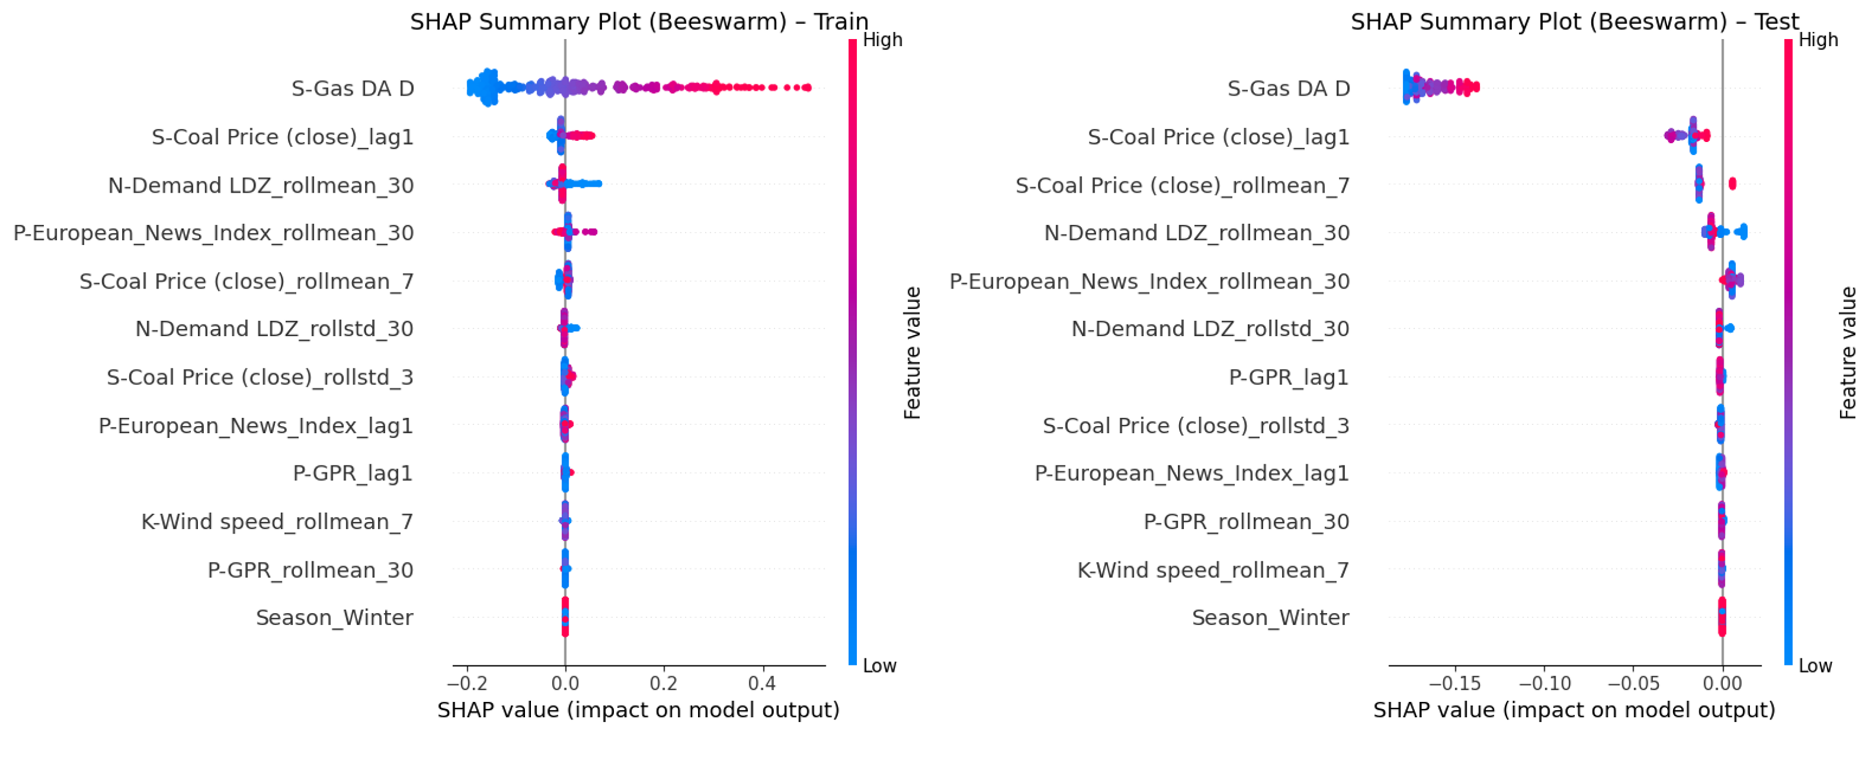
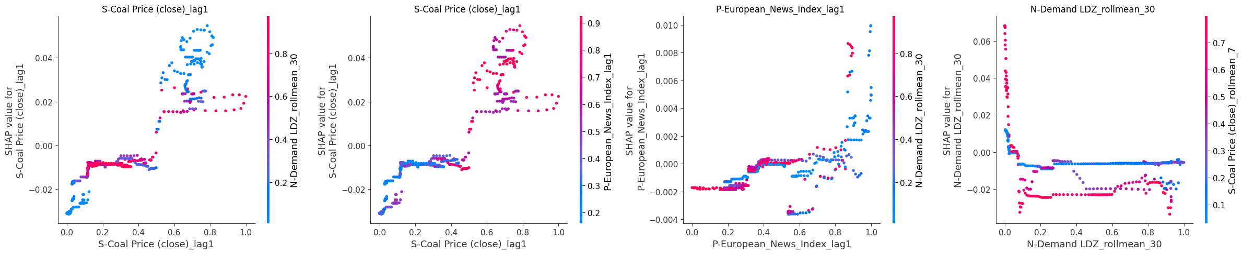
SHAP plots
Summary plots
train vs. test: differed test only negative impacts (likely price peak)
Without gas price: fundamentals more balanced
Dependence plots
Focused on interaction effects between feature pairs
Looked for vertically dispersed, color-gradient clouds as indicators of interactions

Slide 11
Results – trade-off
Practical trade off differs a lot from the theoretical one
However, it is strongly context dependent which was examined during expert interviews

Slide 12
Research questions
RQ1: How do intrinsically interpretable models compare to post-hoc interpreted models?
RQ2: What are the main drivers of gas spot prices and how do they influence predictions?
Performance Gap: EBMs and other transparent models underperform, even linear baselines outperform EBMs
Trade-off Insight: Post-hoc tools like SHAP offer practical interpretability without sacrificing accuracy
Functional Transparency: Sufficient for decision-making in most business contexts
Limits of Simplicity: EBMs fail to capture key interactions (e.g., demand × weather), reducing their practical value
Autoregressive Dominance: Past gas prices are the most predictive input across all models
Additional Drivers: Coal prices (lagged) and rolling gas demand contribute meaningfully
Irrelevant or Contextual Factors: LNG imports, storage levels, and sentiment indices lacked stable predictive power
Context Dependence: Feature relevance varies by market phase, stable correlations exist only in non-volatility regimes
12

Slide 13
Contributions
Theoretical Contributions
Practical Contributions
Developed efficient preprocessing for tabular modeling of time series
Advocated model selection based on data structure, not just performance
Evaluated SHAP’s reliability across models and configurations
Proposed a classification graphic for forecasting models based on interpretability/performance
Delivered expert-reviewed dataset and modular pipeline for gas price modeling
Validated SHAP + XGBoost as an effective combo for price driver analysis
Provided model choice guidelines for different business applications
Enabled replication, customization, and responsible application in volatile markets
13

Slide 14
Limitations and future research
Data Constraints
Methodological Gaps
Research Outlook
Sparse historical data and exclusion of features limited generalizability
Overfitting in tree models due to dominance of autoregressive signals
Phase-specific effects (e.g., crises) distorted long-term learning
No AutoML or hybrid models tested, visual preprocessing introduces subjectivity
Many potential drivers filtered out early, true importance unknown
Lag alignment and temporal leakage remain critical risks in economic ML
Explore causal SHAP, hybrid models (e.g., IXGB), and futures-based predictors
Enhance time-phase analysis: regime separation, shock modeling
Address regulatory requirements (e.g., EU AI Act) for interpretability and auditability
14

Slide 15
Thank you for listening! Any Questions?

Slide 16
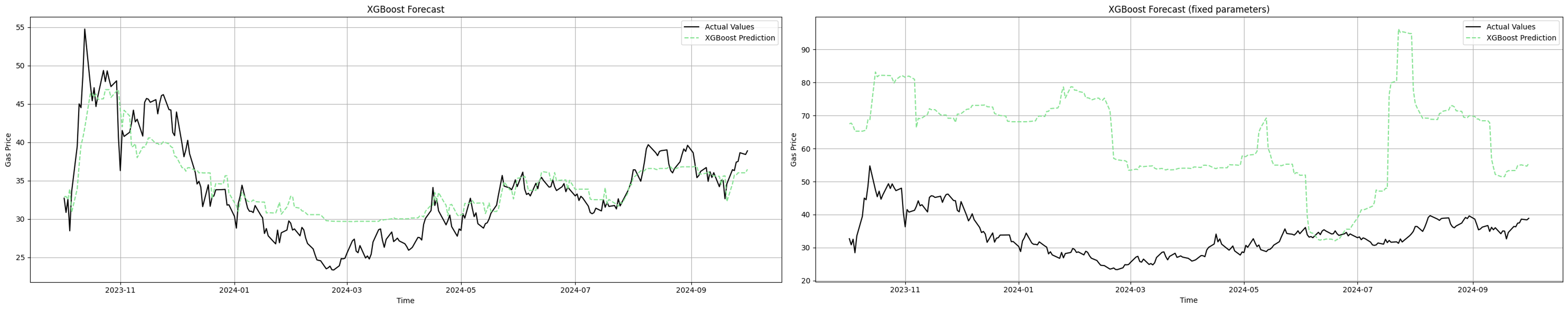
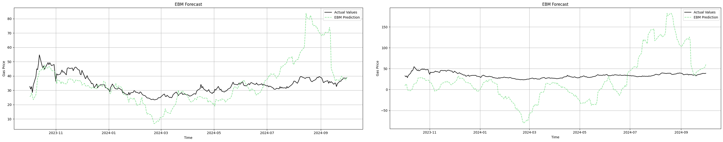
Backup – prediction with and without gas price

Slide 17
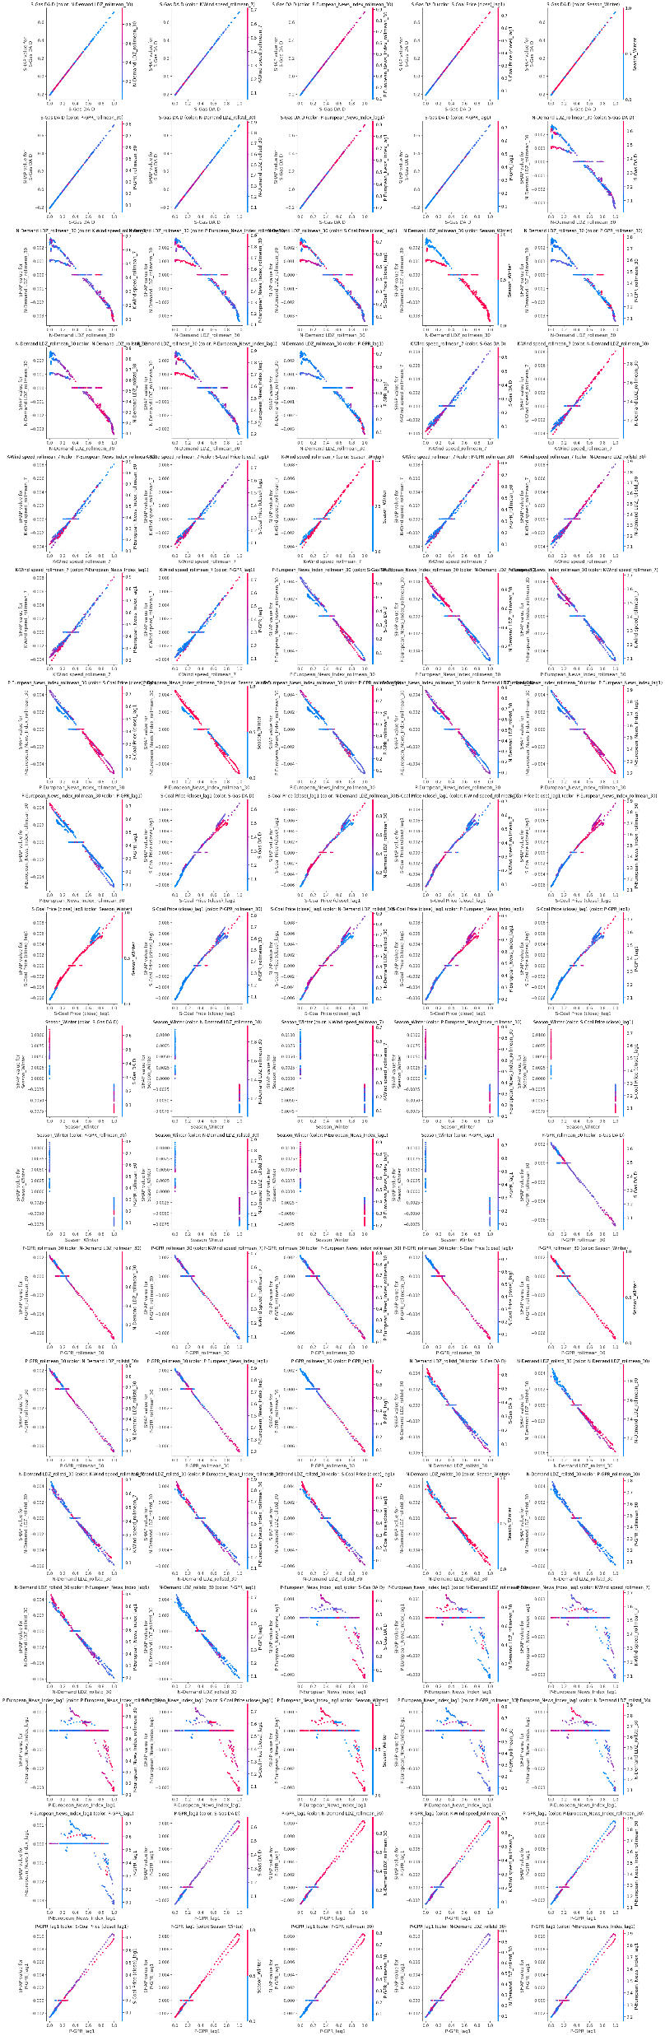
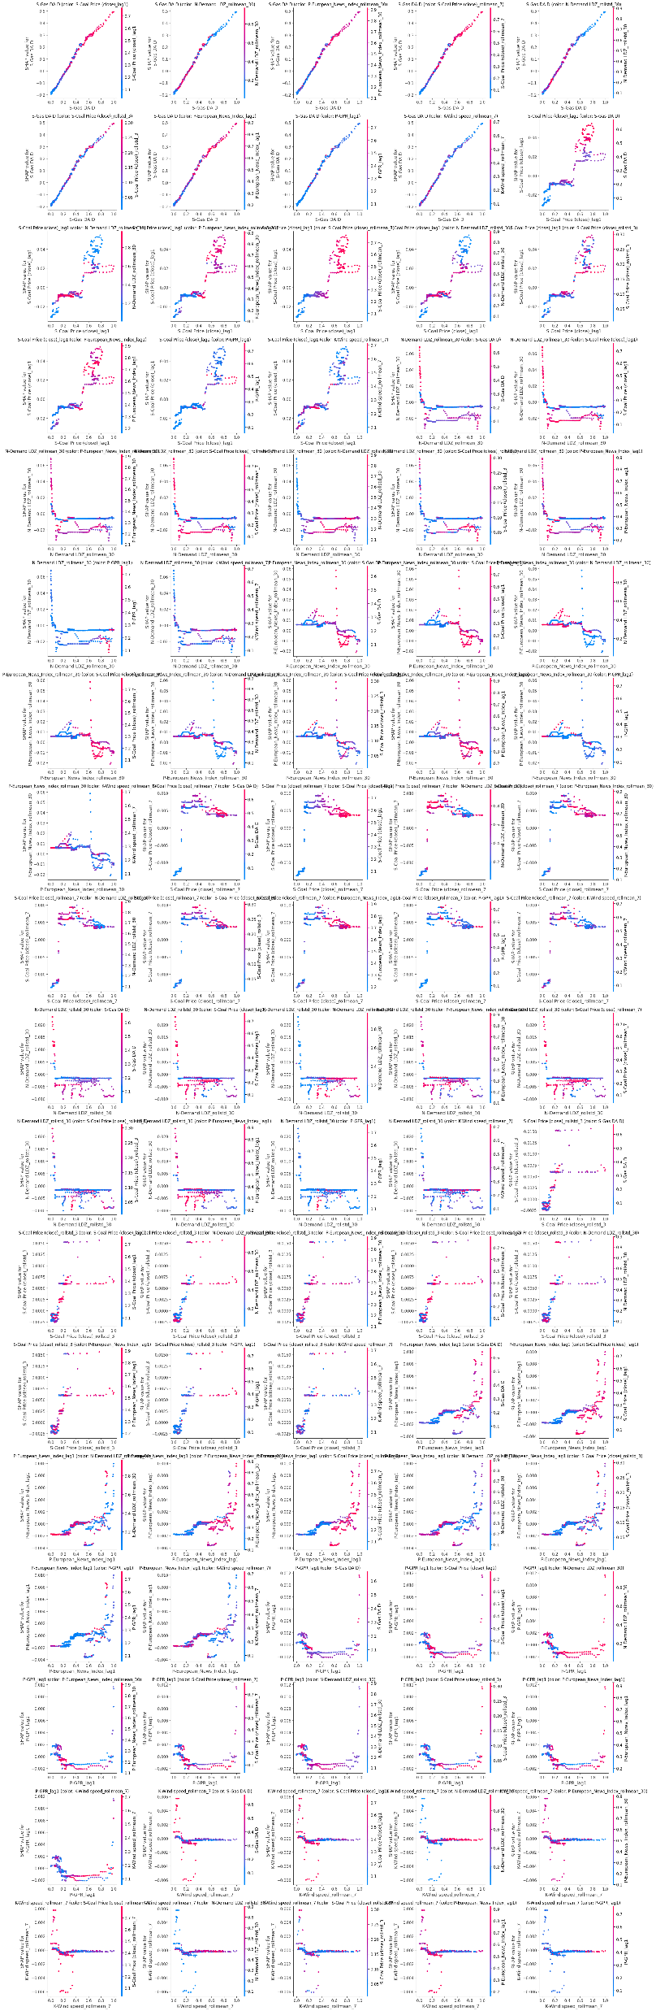
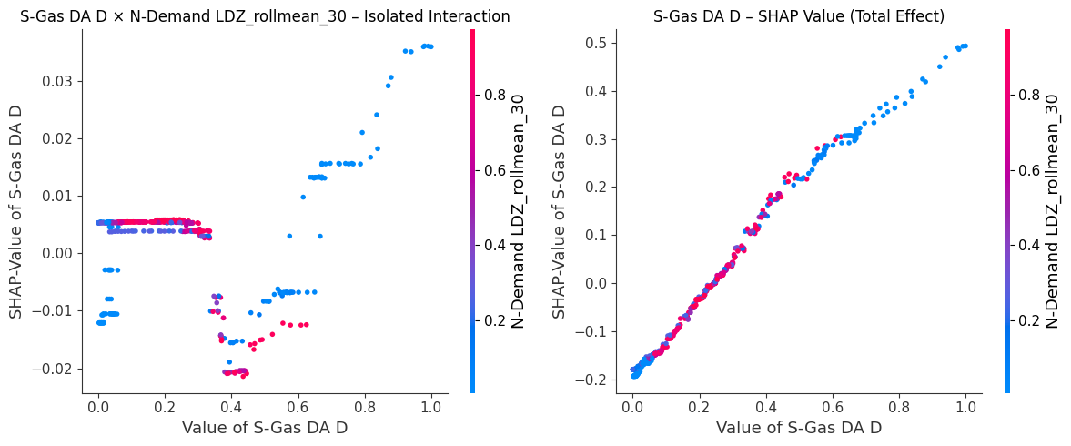
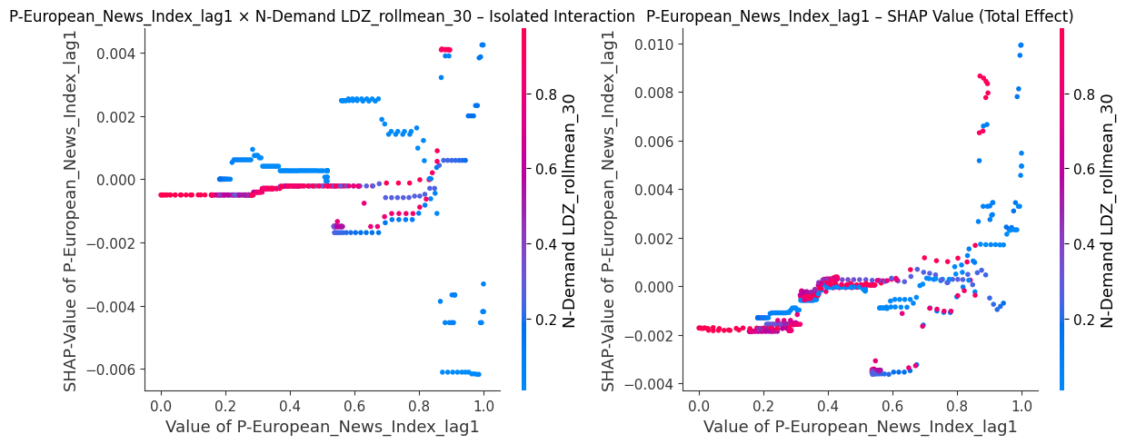
Backup – dependence plots

Slide 18
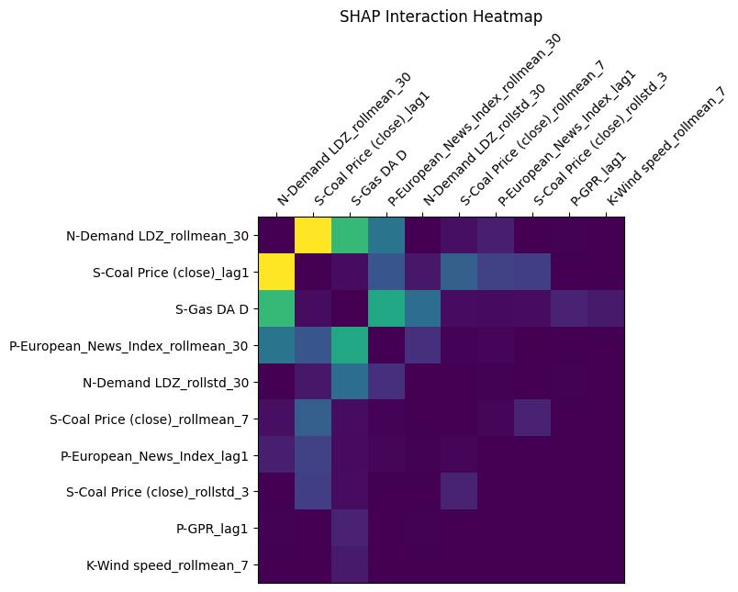
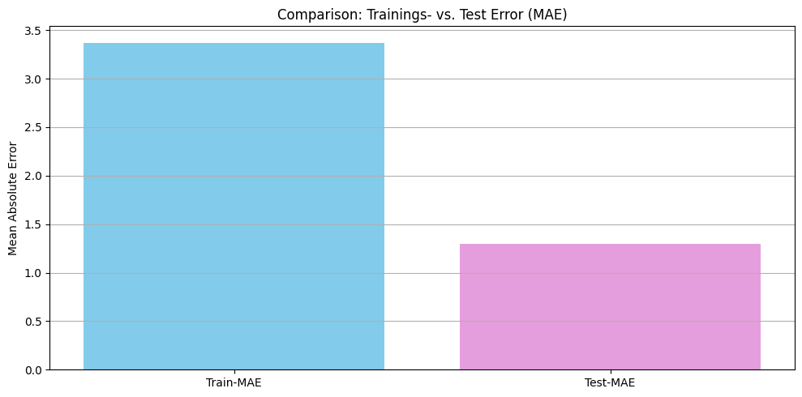
Backup – shap

Slide 19
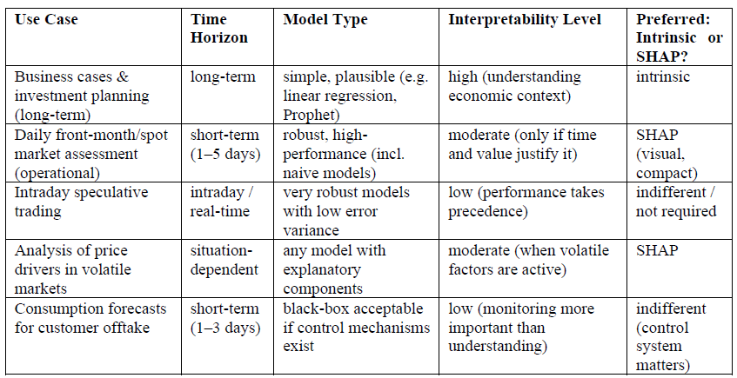
Backup – expert assessment

